Slide 1
COM410 Programming in Practice
Week 1 & 2 – Tutorial / Lab

Slide 2


Reach Out
Email:
serif.salem@qa.com
Serif Refined Material (Password: COM410)
https://tinyurl.com/QACOM410
University Drop Box
https://tinyurl.com/QAULSTER

Slide 3
Content
Available IDEs for Java Programming
Installing JDK and NetBeans
First Java Program in NetBeans
Essential Components of Java Classes
How to Create a New Java Project in NetBeans
Step 1: Creating a Base Class (Person)
Step 2: Creating a Subclass (Student)
Step 3: Testing the Classes (MainClass)
Debugging and Experimentation Tasks

Slide 4
What is JDK?
Java Development Kit (JDK)
JDK is a software development kit (SDK) used to develop and run Java applications. It includes:
Java Runtime Environment (JRE): Needed to run Java programs.
Java Compiler (javac): Converts Java source code into bytecode.
Java Virtual Machine (JVM): Executes Java programs.
Development Tools: Debuggers, profilers, and documentation generators.
👉 Why is JDK Important?
Required for writing, compiling, and executing Java programs.
Includes essential tools for Java application development.

Slide 5
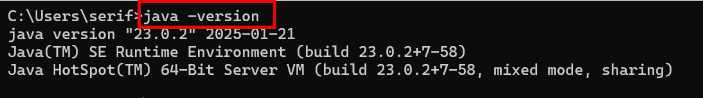
How to Install JDK on Windows
1. Download JDK
Oracle JDK: https://www.oracle.com/java/technologies/downloads/ (Requires login)
OpenJDK (Free Alternative): https://jdk.java.net/ (No login required)
2. Install JDK
Run the installer (.exe file) and follow the setup wizard.
Choose the installation directory (default: C:\Program Files\Java\).
4. Verify Installation
Open Command Prompt (cmd) and type:

Slide 6
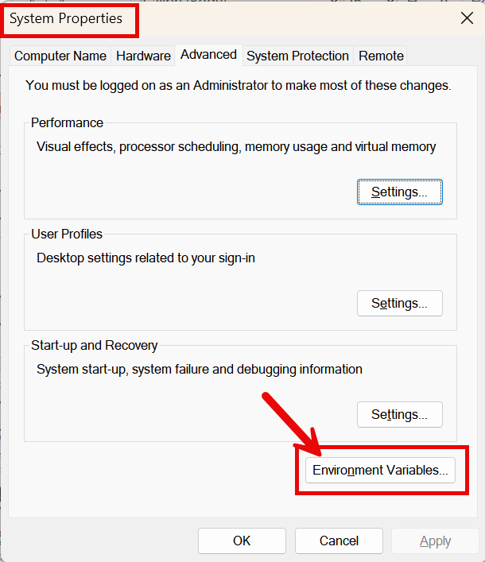
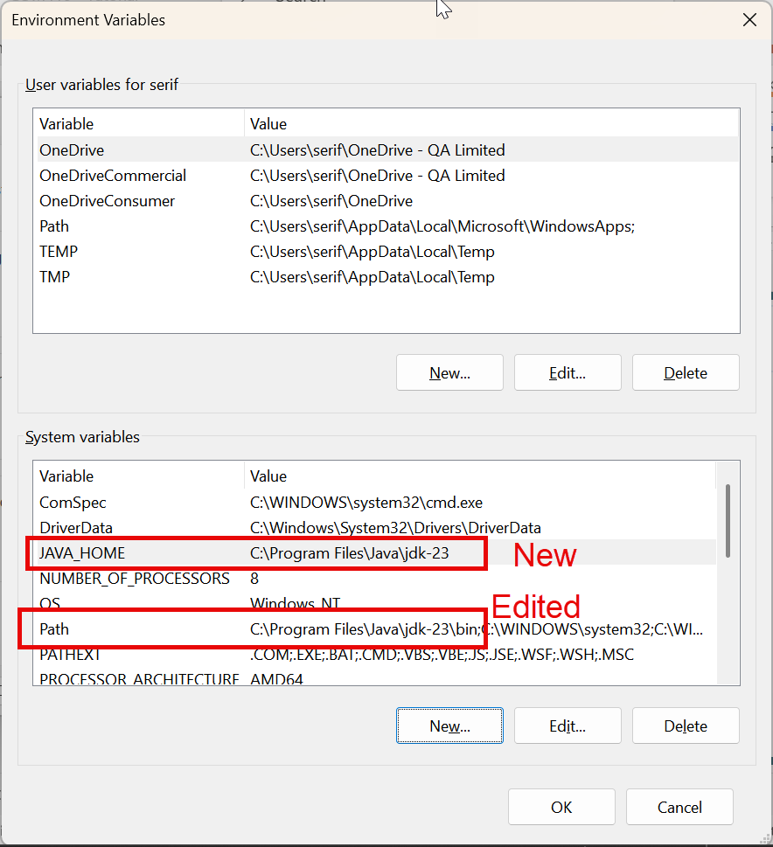
How to Install JDK on Windows
Set Up Environment Variables (Optional, Recommended)
From windows setup – Search for “environment variables” and chose the edit environment.
System Variable - Edit “Path”:
Change path to
“C:\Program Files\Java\jdk-23\bin”
System Variable - Create :
Variable Name: “JAVA_HOME”
Variable value: “C:\Program Files\Java\jdk-23”

Slide 7
Why IDE and JDK
Feature | JDK Only (Command Line) | Using an IDE (NetBeans, Eclipse, IntelliJ)
Code Editing | Basic (Notepad, VS Code) | Advanced (Auto-complete, highlighting)
Compiling | Manual (javac filename.java) | Automatic (One-click build)
Debugging | Manual print statements | Built-in Debugger (Breakpoints, Step Execution)
Project Management | Difficult (Manual file handling) | Easy (Organized project structure)
Best for | Small programs, learning JDK commands | Professional development, complex projects
👉 JDK alone is good for learning basic commands, but an IDE is highly recommended for efficient coding!

Slide 8
How to Install NetBeans for Java Development
1. Download NetBeans
Visit the official Apache NetBeans website: 👉 https://netbeans.apache.org/download/index.html
Select the latest NetBeans Installer for Windows.
Ensure that JDK is installed first, as NetBeans requires JDK to run.
2. Install NetBeans
Run the downloaded NetBeans Installer (.exe) file.
Follow the setup wizard:
Choose the installation path (default: C:\Program Files\NetBeans).
Select Java SE and any additional tools needed.
Click Next and complete the installation.

Slide 9
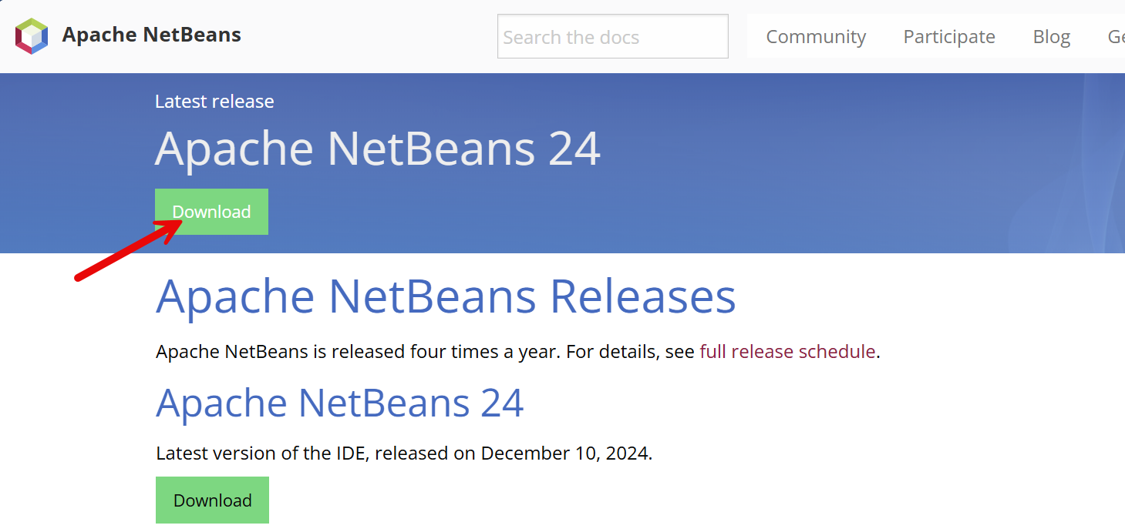
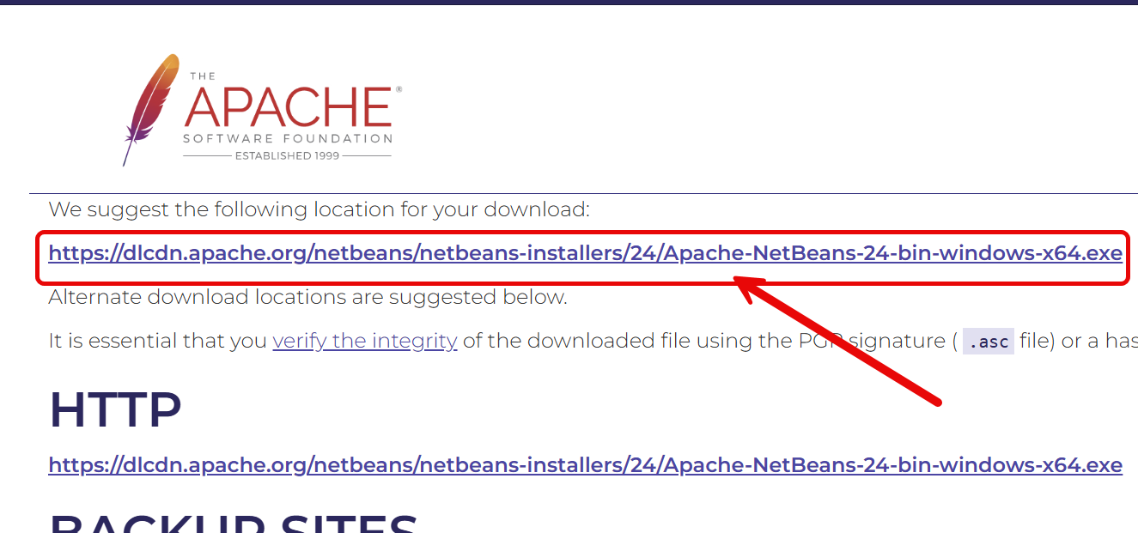
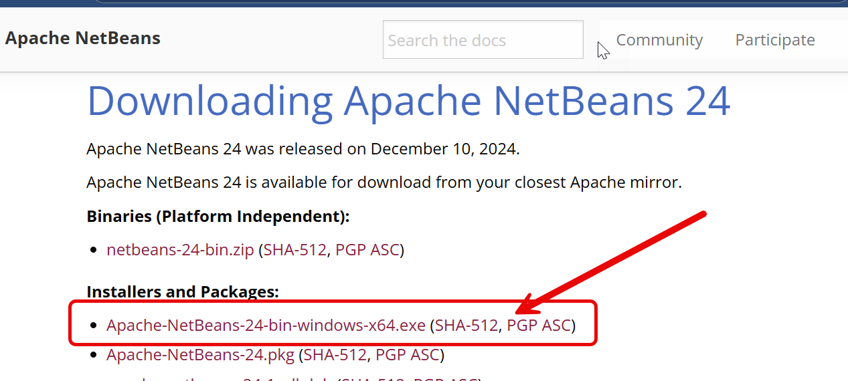
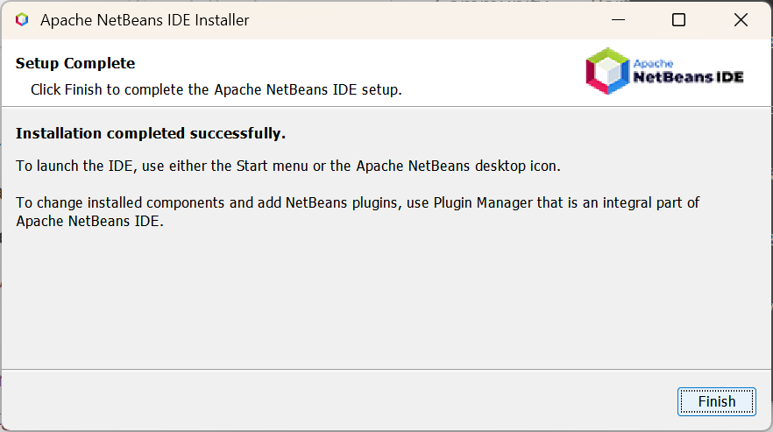
How to Install NetBeans for Java Development

Slide 10
First Java Program in NetBeans
1. Open NetBeans and Create a New Project
Launch NetBeans IDE.
Go to File → New Project.
Select Java → Java Application → Click Next.
Name your project (e.g., Serif_JavaApp) and click Finish.
2. Write and Run a Java Program
In the project window, open Main.java.
Replace the existing code with:
“Hello Class COM410”
Click the Run Button (▶) or press Shift + F6 to execute the program.
The output will appear in the NetBeans Console:

Slide 11
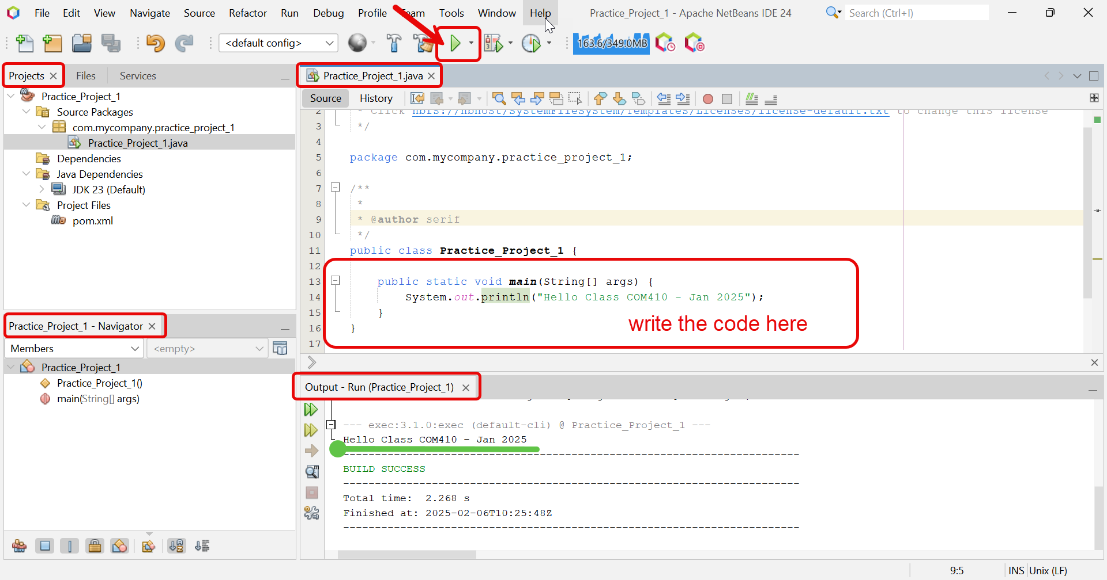

Slide 12
Essential Components of Java Classes
A Java class must include:
1️⃣ Instance Variables – Store data (attributes) for objects. 2️⃣ Constructors – Initialize objects when they are created. 3️⃣ Methods – Define actions (behaviors) that objects can perform.
✅ Why are these important?
Instance variables store object-specific data.
Constructors ensure that objects start with valid values.
Methods allow objects to perform tasks and interact with other objects.

Slide 13
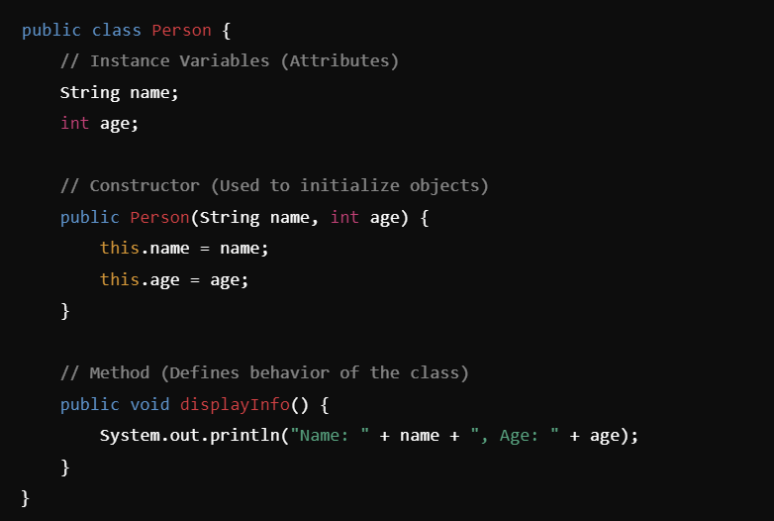
Example of a Java Class with Instance Variables, Constructors, and Methods

Slide 15
How to Create a New Java Project in NetBeans (Without Classes)
1️⃣ Open NetBeans and Start a New Project
Launch NetBeans IDE.Click on File → New Project.
Under Categories, select Java with Ant.
Under Projects, choose Java Application → Click Next.
2️⃣ Configure Project Settings
Enter a Project Name (e.g., Lab_Classes).
Uncheck "Create Main Class" (since we will add classes manually).
Choose the Project Location (default is fine).Click Finish.

Slide 16
How to Add New Classes in NetBeans
1️⃣ Create a New Java Class
In the Projects panel, expand the project folder (Lab_Classes).
Right-click on the src folder → Click New → Java Class.
In the Class Name field, enter the desired class name (e.g., Person).Click Finish.
2️⃣ Modify the Generated Class
NetBeans will generate a basic class:javaCopyEdit
Add instance variables, constructors, and methods as needed.

Slide 17
Step 1: Creating a Base Class (Super Class)
Open NetBeans → Create a new Java project (Lab_Classes).
Inside src, create a new Java class called Person.
Add the following code:
public class Person {
String name;
int age;
// Constructor
public Person(String name, int age) {
this.name = name;
this.age = age;
}
// Method to display info
public void displayInfo() {
System.out.println("Name: " + name + ", Age: " + age);
}
}

Slide 18
Step 2: Creating a Subclass (Inheritance)
Inside src, create another class called Student.
Extend the Person class using extends:
public class Student extends Person {
String studentID;
// Constructor using super()
public Student(String name, int age, String studentID) {
super(name, age);
this.studentID = studentID;
}
// Method to display student details
public void displayStudent() {
System.out.println("Student ID: " + studentID);
displayInfo(); // Calling the superclass method
}
}

Slide 19
Step 3: Testing the Classes (Main Method)
Inside src, create a new class called MainClass.
Add the following main method to test the classes:
public class MainClass {
public static void main(String[] args) {
// Creating a Person object
Person p1 = new Person("Alice", 35);
p1.displayInfo();
// Creating a Student object
Student s1 = new Student("Bob", 20, "S12345");
s1.displayStudent();
}
}

Slide 20
Debugging and Experimentation
✅ Task 1: Modify the Person class to include a new variable nationality.
✅ Task 2: Add a method in Student to check if the student is a minor (age < 18).
✅ Task 3: Create another subclass Teacher that extends Person and includes a subject variable.

